Slide 1



Chatbot Using
LLM
Name: Darshan Gohil
Branch: IT
Enroll No: 22002170210019
Roll No: 299

Slide 2

OVERVIEW
ADVANTAGES
CHALLENGES
APPLICATIONS
What is Chatbot?
Software application for text or voice-based conversation.
What are Large Language Models (LLMs)?
AI models trained on massive datasets of text.
Capable of understanding and generating human-like responses.

Slide 3

OVERVIEW
ADVANTAGES
CHALLENGES
APPLICATIONS
Advantages
Improved user experience
Reduced workload on human agents
Handles large volumes of queries
Cost-efficient solution

Slide 4
OVERVIEW
ADVANTAGES
CHALLENGES
APPLICATIONS
Challenges
Bias in responses
Data privacy concerns
Misinterpretation of queries

Slide 5
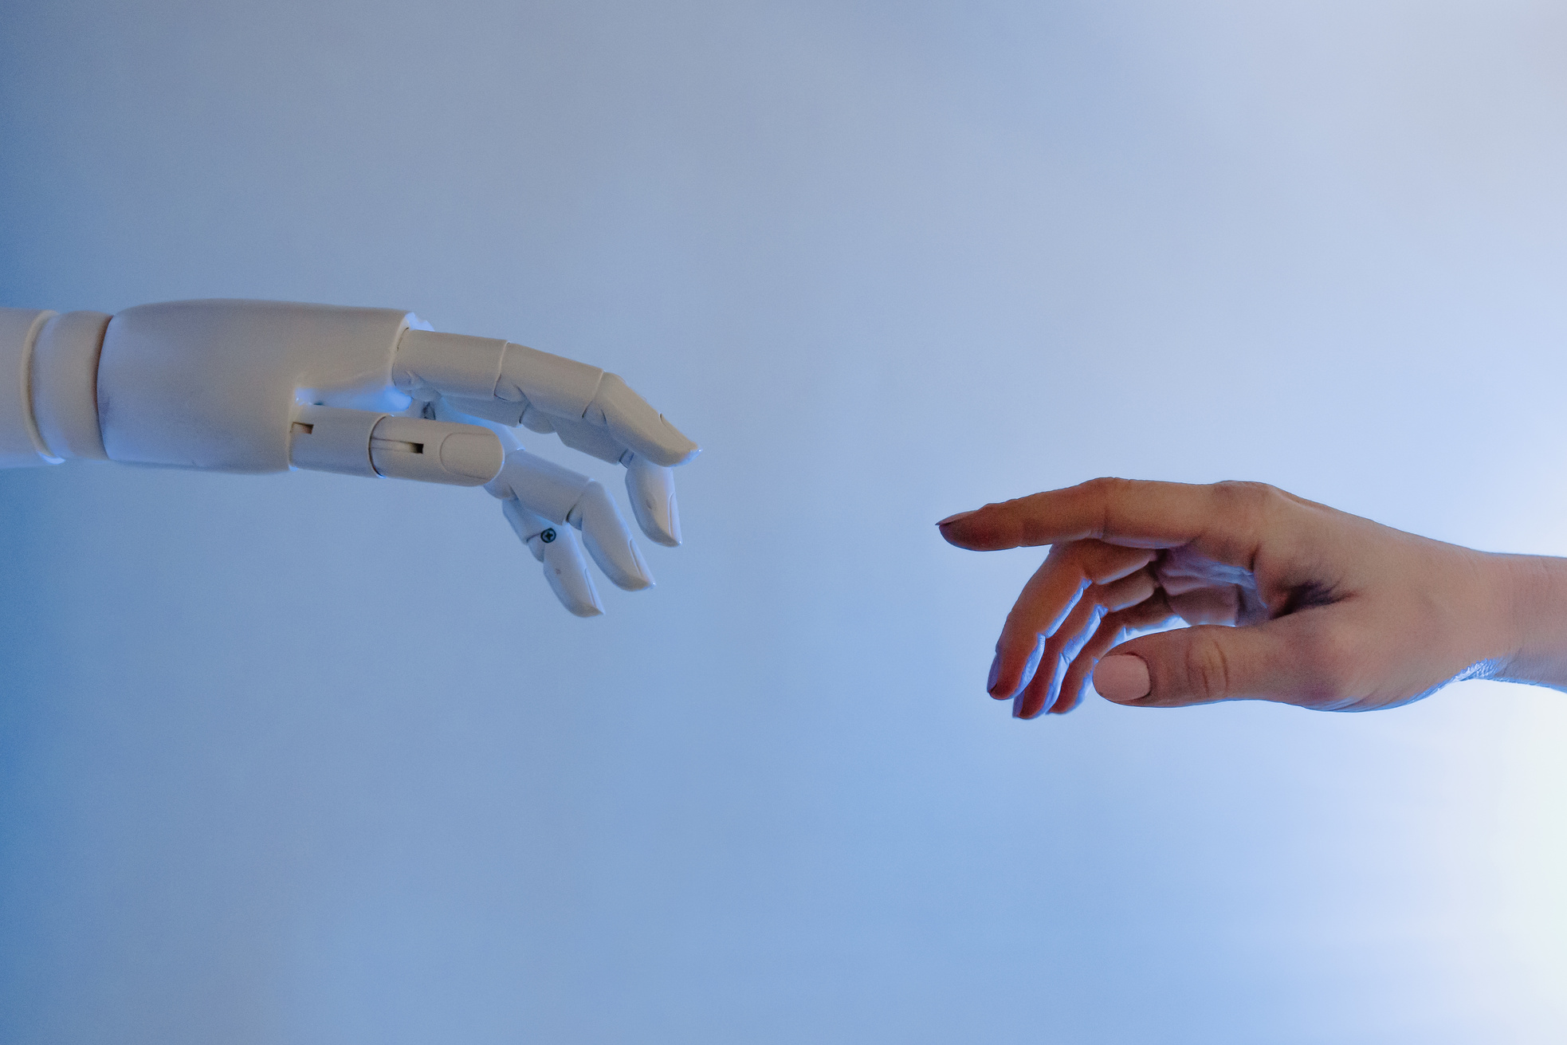
OVERVIEW
ADVANTAGES
CHALLENGES
APPLICATIONS
Applications
Customer Support: 24/7 assistance
Education: Tutoring answering queries
Entertainment: Companionship, Storytelling
E-commerce: Personalized recommendations

Slide 6

Conclusion
LLM-powered Chatbots are transforming human-machine interaction
Provide natural, intelligent and scalable conversations

Slide 7

Thank You

